Slide 1

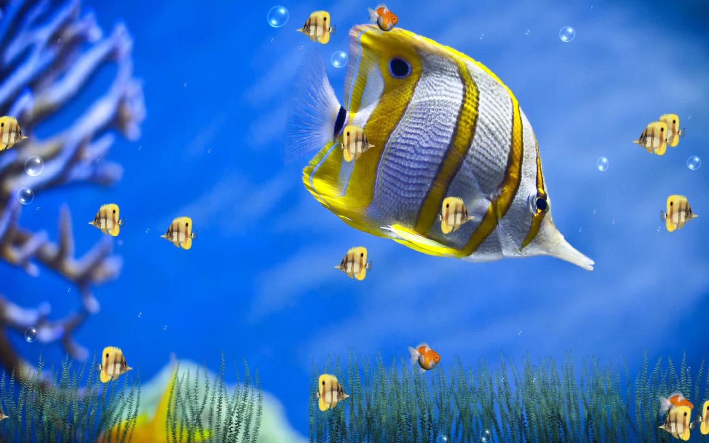
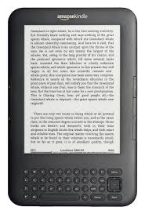

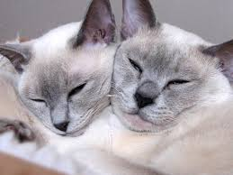
Welcome To English Class

Slide 2

Nizam Uddin Jewel
Assistant teacher
Bahercor govt.primary school
Raipura, Narsingdi
Email:nizamuddinjewel@gmail.com
Skypee:nizamuddinjewel
Facebook:Nizam Uddin Jewel

Slide 3


Class:Four
Sub:English
Lesson:24, Poem:Tails
Unit:Last 11 lines Page:82

Slide 4


Students will be able to:
read the poem with correct pronunciation and stress.
2)Know about animals tails and use of tails.

Slide 5


Safe learning environment:
by watching video clip

Slide 6
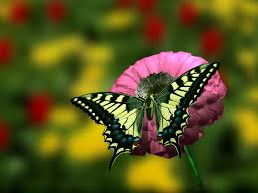

Tails
Myra Cohn Livingstone

Slide 7
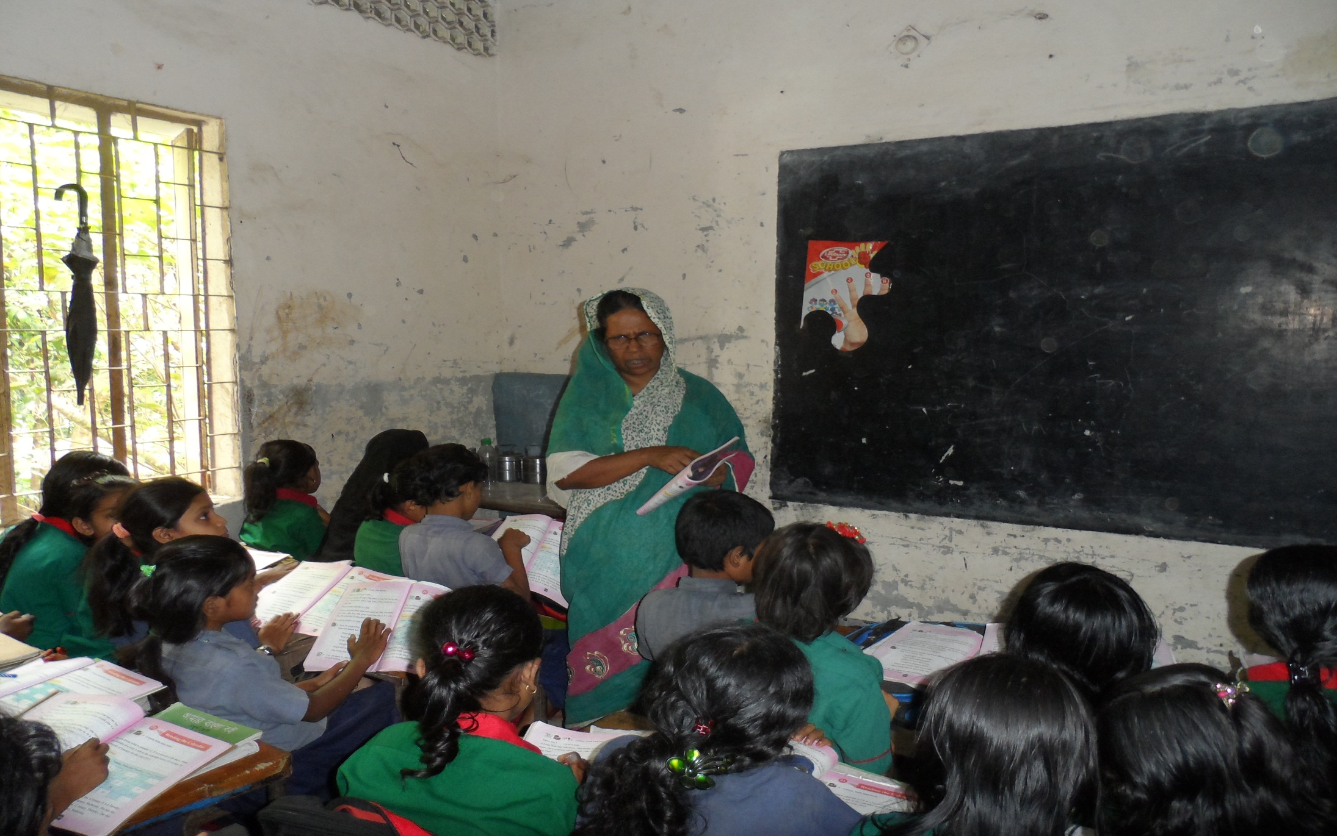

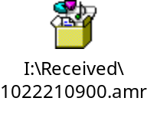
Teachers loud reading
Class:4
Sub:English
Tails
Myra Cohn Livingstone

Slide 8

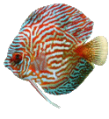
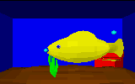
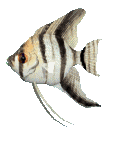


And a fish has a tail
that can
help him
to swim,

Slide 9
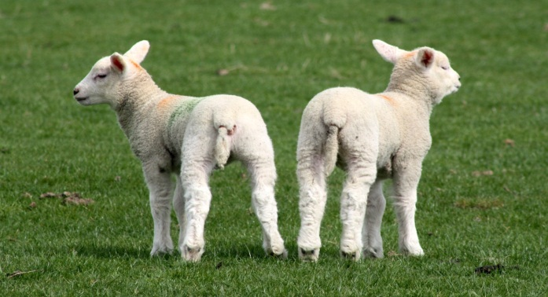
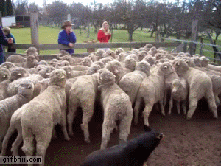

And a sheep has a tail
That looks curly on him

Slide 10
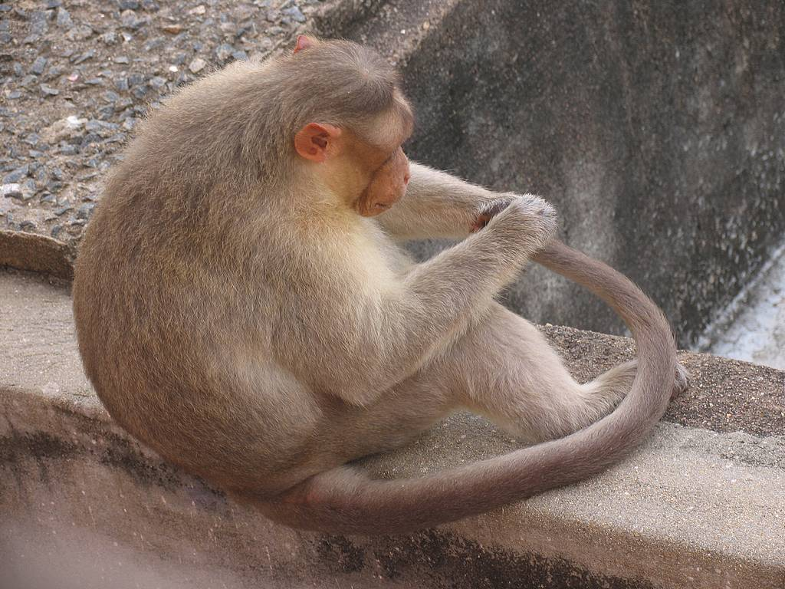
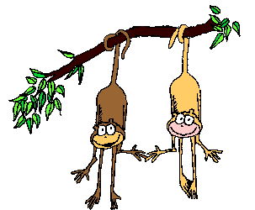
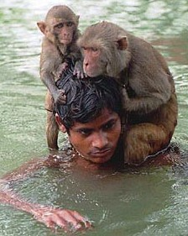
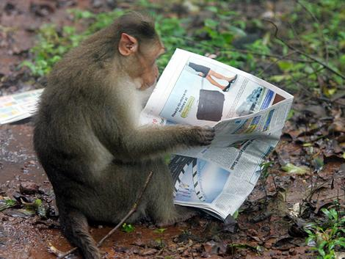
All the monkeys has a tails

Slide 11
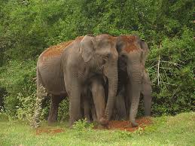
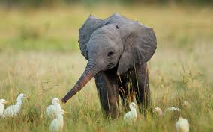
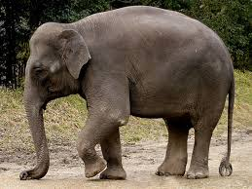
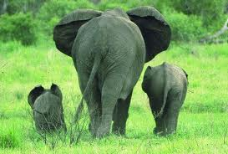
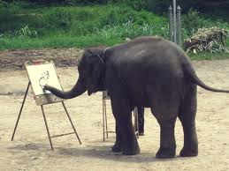
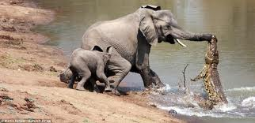
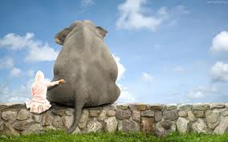
And the elephants too

Slide 12

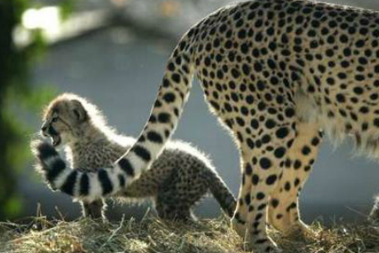
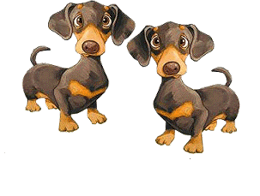
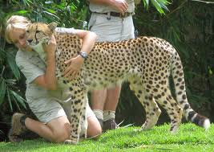
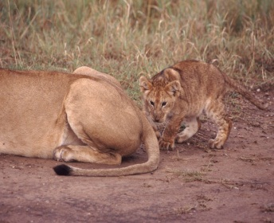
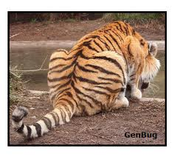
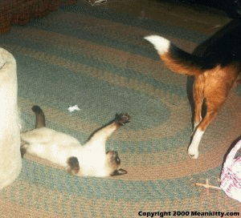
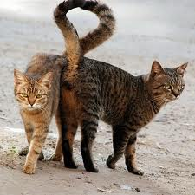
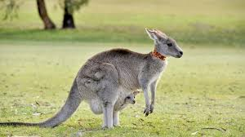
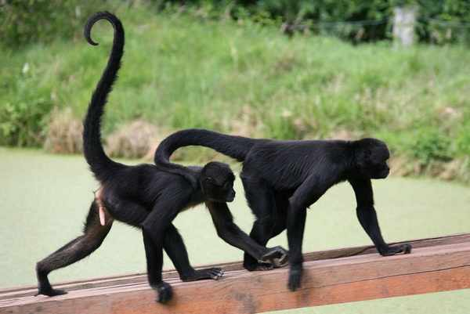
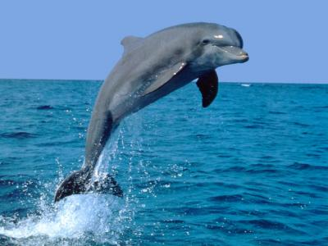
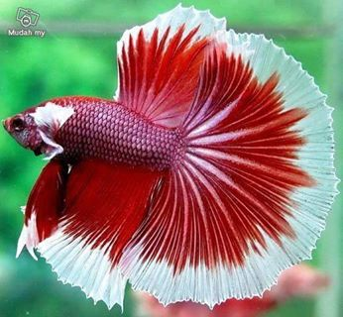
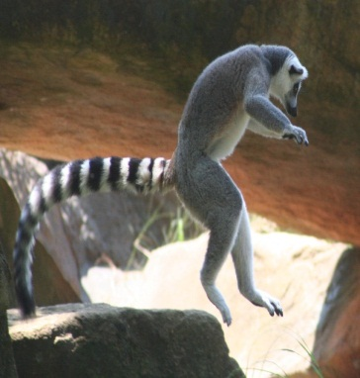
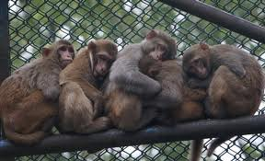
There are hundreds of tails

Slide 13
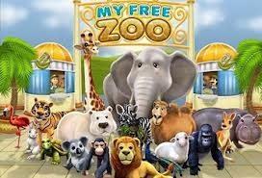
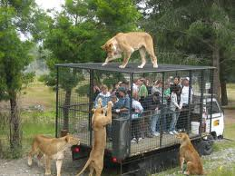
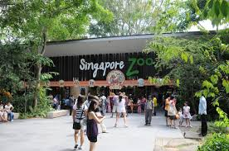
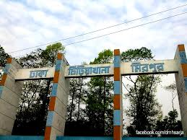
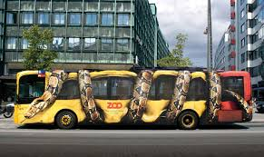
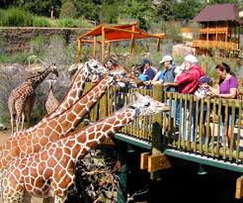
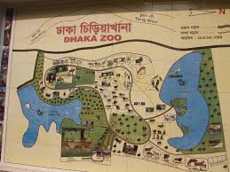
If
you
look
in
the
zoo !

Slide 14
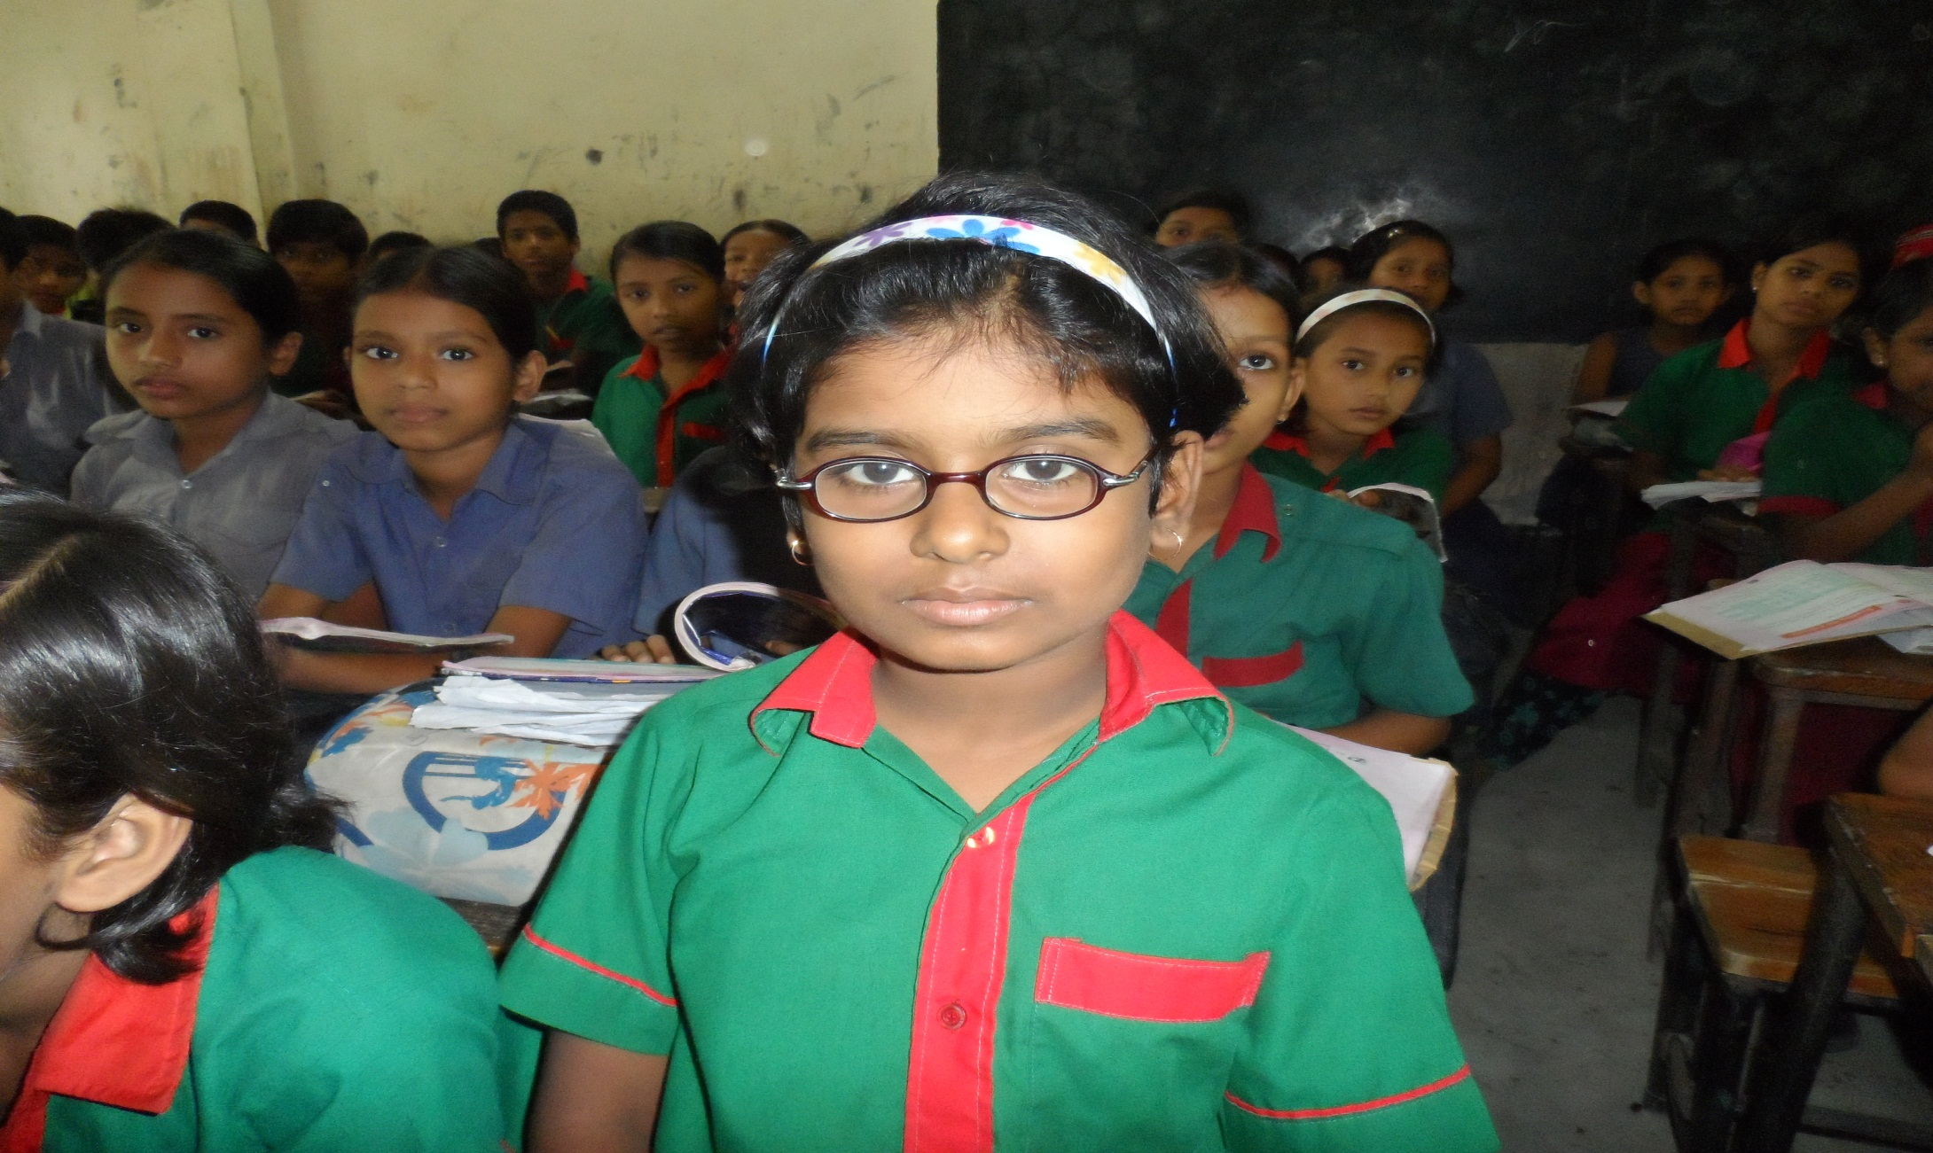
Students
loud
reading

Slide 15

New words:
Swim
Curly
Zoo

Slide 16
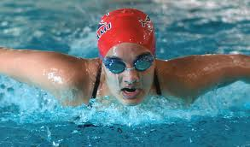
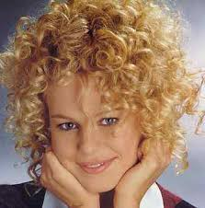
Word meaning
Swim: to do exercise in water
Curly: wavy/up and down
Zoo: a place where many kinds of animals live in cage

Slide 17
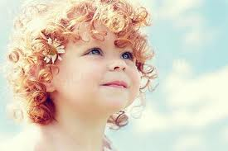
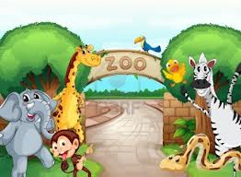
Make sentences
Swim: Fish swim in water
Curly: Her hair is curly
Zoo: We can see many animals at the zoo.

Slide 18
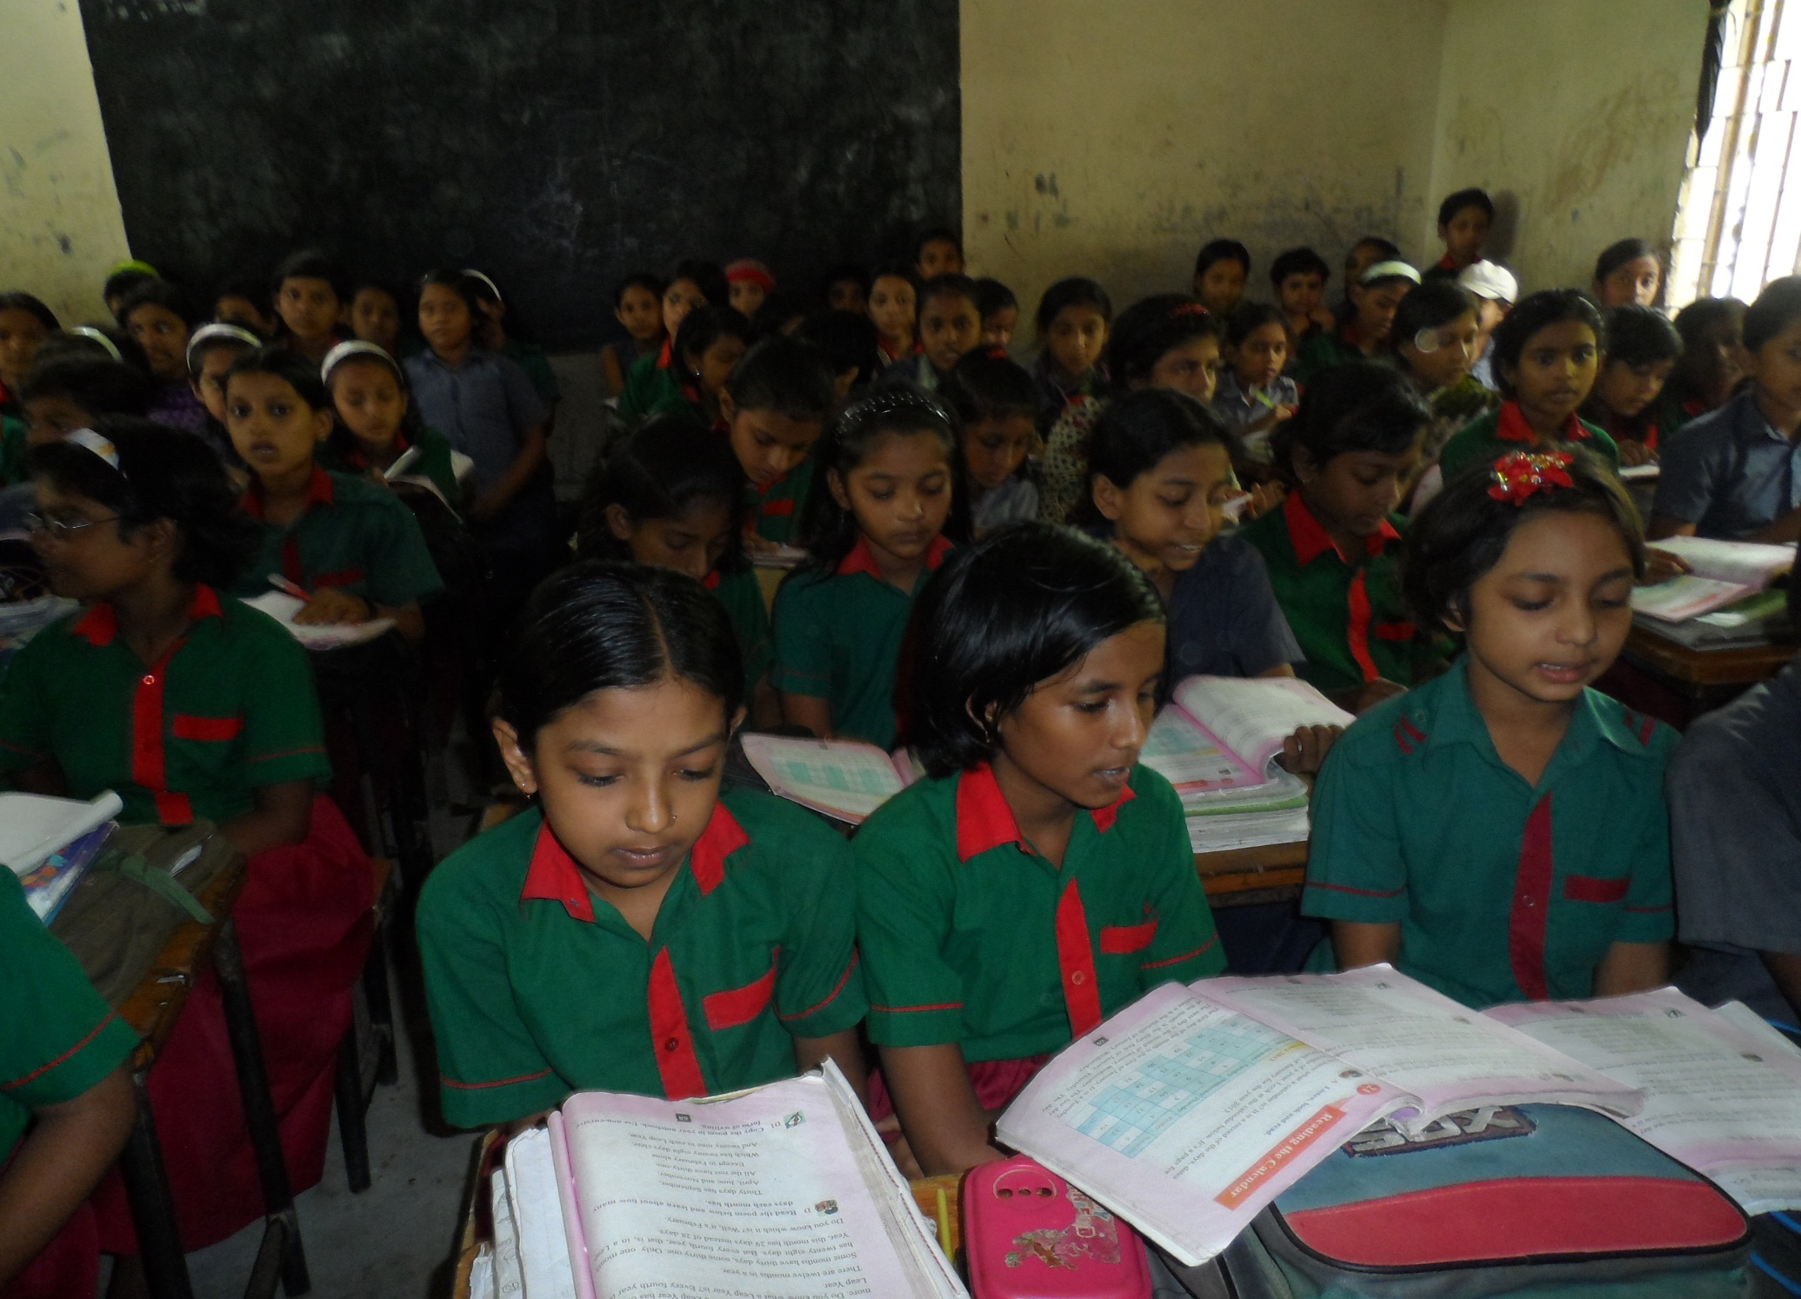
Silent reading

Slide 19

Rearrange lines
And a fish has a tail
That can
Help him
…………….
And a sheep has a tail
That looks
……………..
………………………
And the elephants too
……………………
If you look in the zoo!
to swim,
curly on him.
All the monkeys have tails
There are hundred of tails

Slide 20



Group A
And a fish has a tail
That can
Help him
To swim
Group work
Read poem
In group
Group C
All the monkeys have tails
And the elephants too
There are hundred of tails
If you look in the zoo!
Group B
And a sheep has a tail
That looks
Curly on him.

Slide 21

Home work.
Write 5 animals name and describe about their tails.

Slide 22

Thanks my dear students.
see you
next class.

